Slide 1
EARLY DETECTION OF CHRONIC KIDNEY DISEASE USING MACHINE LEARNING
GUIDED BY PRESENTED BY
MRS.DIALA MRS.LALITHA GAYATHRI JEYAPACKIAM R
AP/CSE INDUSTRY MENTOR BUVANESWARI R
FACULTY MENTOR IBM SARAVANAPRIYA K
NITHYA P

Slide 2
AGENDA
INTRODUCTION
OBJECTIVE
PROBLEM STATEMENT
EXISTING SYSTEM
PROPOSED SYSTEM
REQUIREMENTS
MODULES
SCREENSHOTS

Slide 3
INTRODUCTION
Chronic Kidney Disease prediction is one of the most important issues in healthcare analytics. The most
interesting and challenging tasks in day-to-day life is prediction in medical field.
10% of the population worldwide is affected by chronic kidney disease (CKD), and millions die each year because they do not have access to affordable treatment.
Chronic kidney Disease can be cured, if treated in theearly stages. The main aim of this project is to predict whether the patient have chronic kidney disease or not, in more accurate and faster way based on certain diagnostic measurements like Blood Pressure (Bp), Albumin(Al).

Slide 4
OBJECTIVE
The main aim of this application is early prediction and proper treatments can possibly stopor slow the progression of this disease to end stage.
The main goal of treatment is to prevent progression of CKD to complete kidney failure.
The best way to do this is to diagnose CKD early and control the underlying cause.
The symptoms, evaluation, and management of CKD will be reviewed here.
Can generate revenue through direct customers.
Can collaborate with health care sector and generate revenue from their customers.

Slide 5
PROBLEM STATEMENT
Chronic kidney Disease can be cured, if treated in the
early stages here we are going to predict whether the
patient have chronic kidney disease or not, in more
accurate and faster way by measure the severity of the
problem and we make use of such information to build a
machine learning model that predicts Chronic Kidney
Disease that based on certain diagnostic measurements
like Blood Pressure (Bp), Albumin(Al) levels. early
prediction and proper treatments can possibly stop or
slow the progression of this disease to end stage.

Slide 6
EXISTING SYSTEM
In Existing system the severe of kidney disease measured by commonsymptoms, such as blood in your pee (urine),
an increased need to pee particularly at night,
difficulty sleeping (insomnia),itchy skin so its takes time to find out the disease.

Slide 7
PROPOSED SYSTEM
The Proposed system is to check whether the patient have chronic kidney disease or not, in more accurate and faster way based on certain diagnostic measurements like Blood Pressure (Bp), Albumin(Al) .This helps kidney patients to cure in earlystages to take prescribed activities and foods .This method is very helpful for poor people.

Slide 8
REQUIREMENTS
Functional Requirements
FR No. | Functional Requirement | Sub Requirement (Story / Sub-Task)
FR-1 | User Registration | Registration through FormRegistration through Gmail
FR-2 | User Confirmation | Confirmation via EmailConfirmation via OTP
FR-3 | Markers of kidney damage | Albuminuria (ACR ≥ 30 mg/g)Urine sediment abnormalitiesElectrolyte and other abnormalities due to tubulardisordersAbnormalities detected by histologyStructural abnormalities detected by imagingHistory of kidney transplantation
FR-4 | Decreased GFR | GFR <60 ml/min/1.73 m2

Slide 9
Non Functional Requirements
FRNo. | Non-FunctionalRequirement | Description
NFR-1 | Usability | Proposed system to check whether the patient havechronic kidney disease or not, in more accurate andfasterwaybasedoncertaindiagnosticmeasurementslikeBloodPressure(Bp),Albumin(Al)
NFR-2 | Security | The main aim of this application is early predictionand proper treatments can possibly stop or slow theprogressionofthisdiseasetoendstagealso itsecurepatientspersonneldata.
NFR-3 | Reliability | This helps kidney patients to cure in early stages totakeprescribedactivitiesandfoods. Thismethod isveryhelpfulforpoorpeople.
NFR-4 | Performance | ChronickidneyDisease can be cured, if treatedinthe early stages here we are going topredict whether thepatient have chronic kidney disease or not, in moreaccurate and faster way bymeasure the severity oftheproblem and we make use of such information tobuildamachine learning model that predicts ChronicKidneyDisease that based on certain diagnosticmeasurementslike Blood Pressure (Bp), Albumin(Al) levels. earlyprediction and proper treatments can possibly stop orslowtheprogressionofthisdiseasetoendstage.
NFR-5 | Availability | kidneypatientscancureinearlystagestotakeprescribedactivitiesandfoods.
NFR-6 | Scalability | In Existing system the severe of kidney diseasemeasured by common symptoms, such as blood inyour pee(urine),an increased need to pee particularly at night,difficulty sleeping (insomnia),itchy skin so its takestime to find outthe disease.But in our Proposedsystem to check whether the patient have chronickidney disease or not, in more accurate and fasterwaybasedoncertaindiagnosticmeasurementslikeBloodPressure(Bp),Albumin(Al)

Slide 10
MODULES
This application is designed into four independent modules which take care of different tasks efficiently.
Module 1
Module 2
Module 3
Module 4

Slide 11
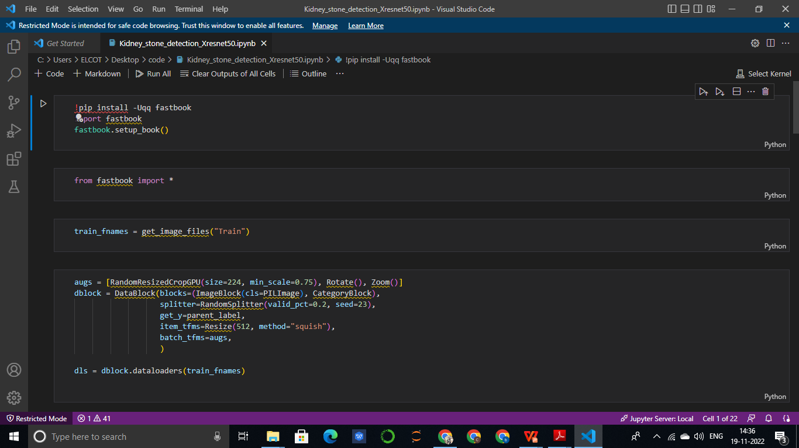
OUTPUT SCREEN

Slide 12
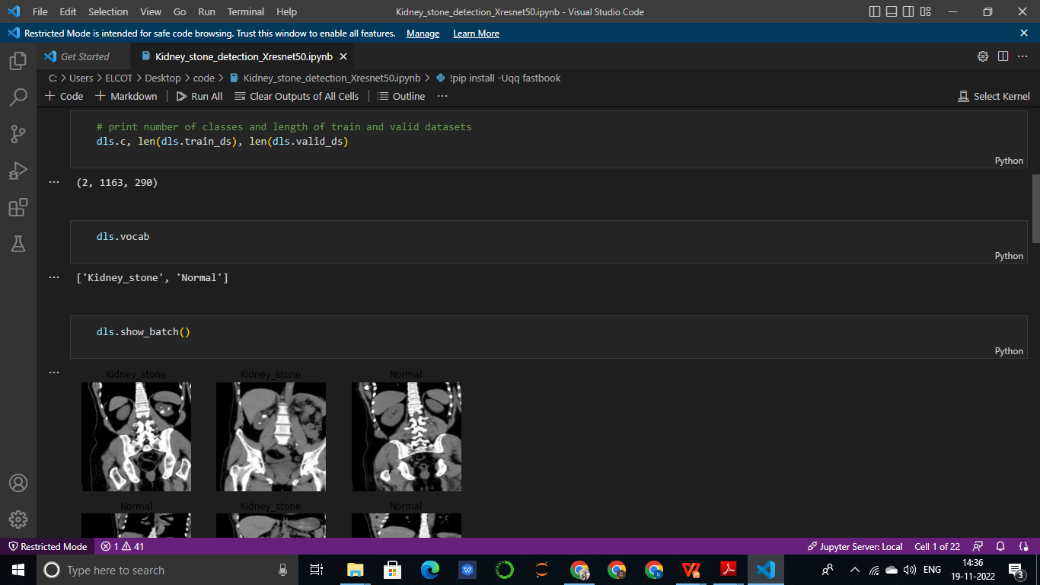

Slide 13
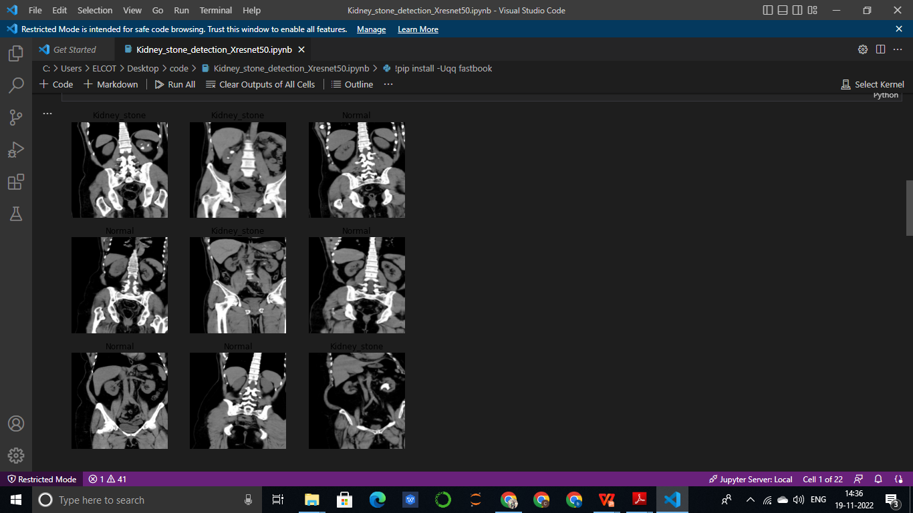

Slide 14
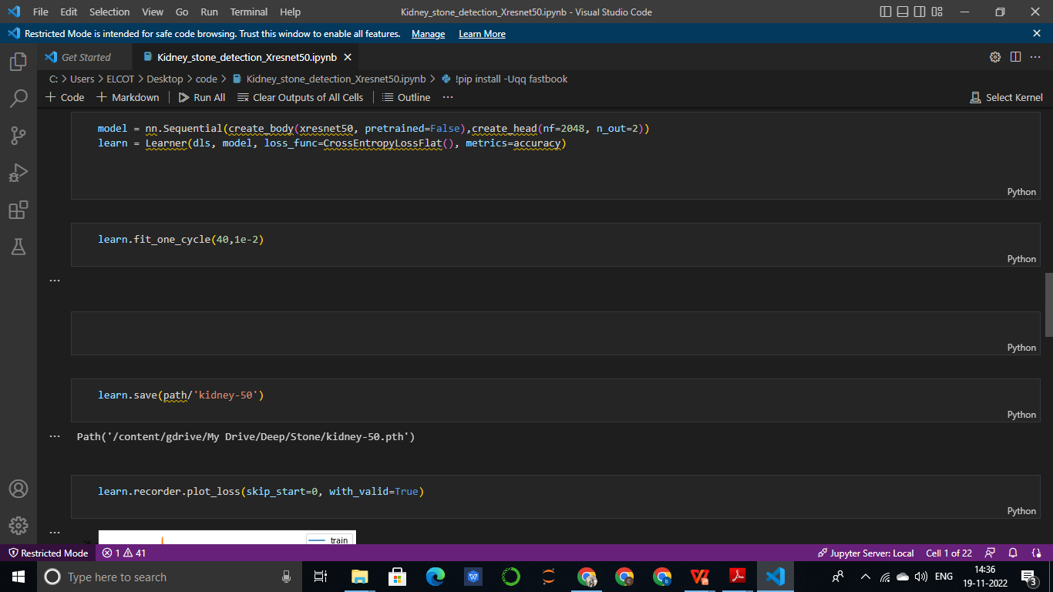

Slide 15
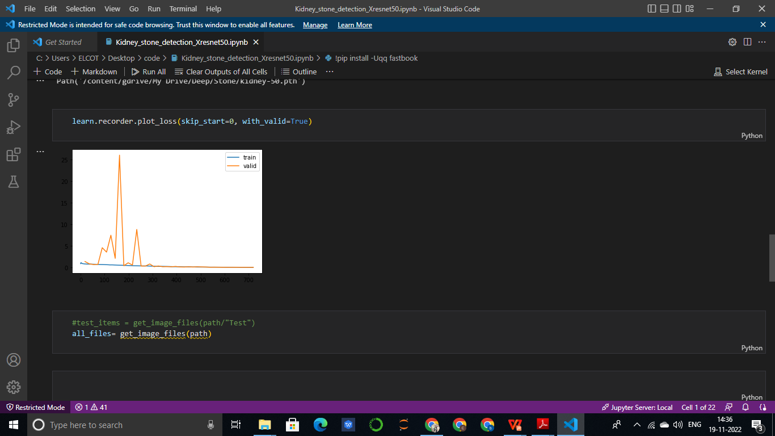

Slide 16
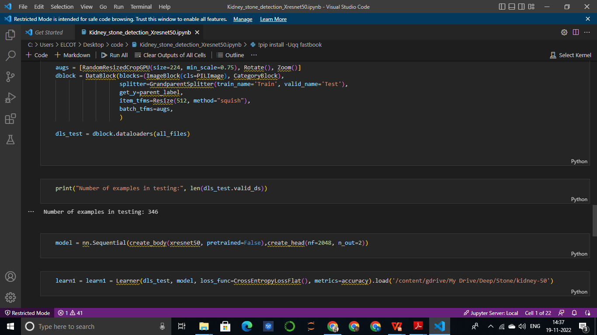

Slide 17
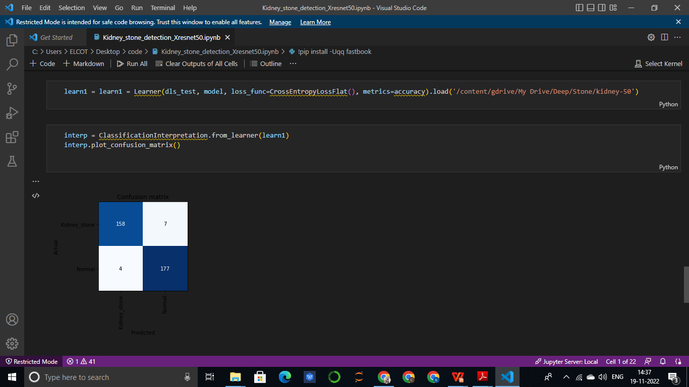

Slide 18
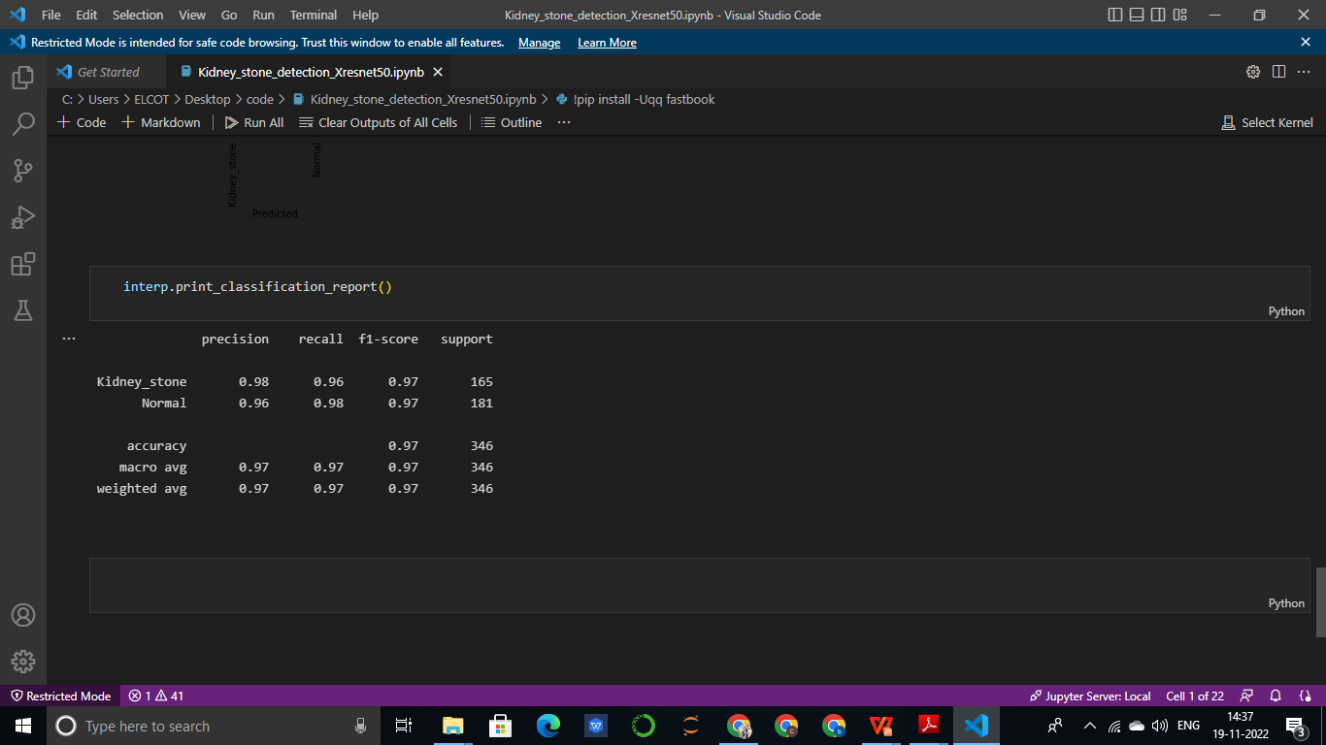

Slide 19
REFERENCE
https://www.uptodate.com/contents/early-detection-of-chronic-kidney-disease
https://www.webmd.com/a-to-z-guides/understanding-kidney-disease-basic-information
1. M. P. N. M. Wickramasinghe, D. M. Perera and K. A. D. C. P. Kahandawaarachchi,
"Dietary prediction for patients with Chronic Kidney Disease (CKD) by considering blood
potassium level using machine learning algorithms," 2017 IEEE Life Sciences Conference (LSC),
Sydney, NSW, 2017, pp. 300-303.
2. H. A. Wibawa, I. Malik and N. Bahtiar, "Evaluation of Kernel-Based Extreme Learning Machine
Performance for Prediction of Chronic Kidney Disease," 2018 2nd International Conference on
Informatics and Computational Sciences (ICICoS), Semarang, Indonesia, 2018, pp. 1-4
3. U. N. Dulhare and M. Ayesha, "Extraction of action rules for chronic kidney disease using Naïve
bayes classifier," 2016 IEEE International Conference on Computational Intelligence and Computing
Research (ICCIC), Chennai, 2016, pp. 1-5.
4. H. Zhang, C. Hung, W. C. Chu, P. Chiu and C. Y. Tang, "Chronic Kidney Disease Survival
Prediction with Artificial Neural Networks," 2018 IEEE International Conference on
Bioinformatics and Biomedicine (BIBM), Madrid, Spain, 2018, pp. 1351-1356

Slide 20
THANKYOU

